Slide 1
NE 591: Advanced Reactor Materials
Fall 2021
Dr. Benjamin Beeler

Slide 2
molten salts

Slide 3
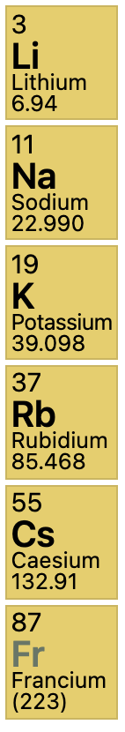
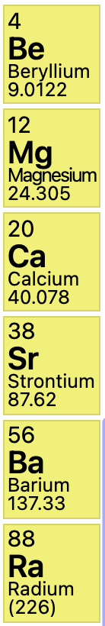
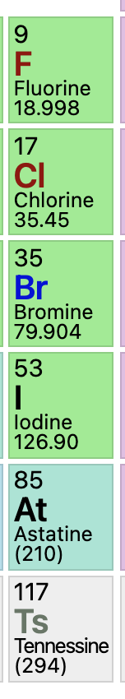
What are molten salts?
Alkali Metals
Alkaline Earths
Halogens
Salts are ionic compounds formed from a combination of electronegative and electropositive elements
At elevated temperatures salts liquefy and are termed “molten salts”
Halide salts are ionic compounds formed from the combination of a halogen (electronegative) and another electropositive element – commonly, but not exclusively, alkali metals or alkaline earths
Examples: LiF, BeF2, MgCl2, NaCl (aka table salt), ZrF4, RbF, UF4, UCl3

Slide 4
Molten Salt Reactors
Salt Cooled Reactor
Driven by some traditional fuel type in cladding, where the coolant is replaced with molten salt
Static Salt Fueled Reactor
The fuel itself is a liquid actinide-salt mixture contained in a cladding, often coupled with a salt coolant
Flowing Salt Fueled Reactor
The fuel itself is a liquid actinide-salt mixture which flows in a loops through the core and doubles as the coolant

Slide 5
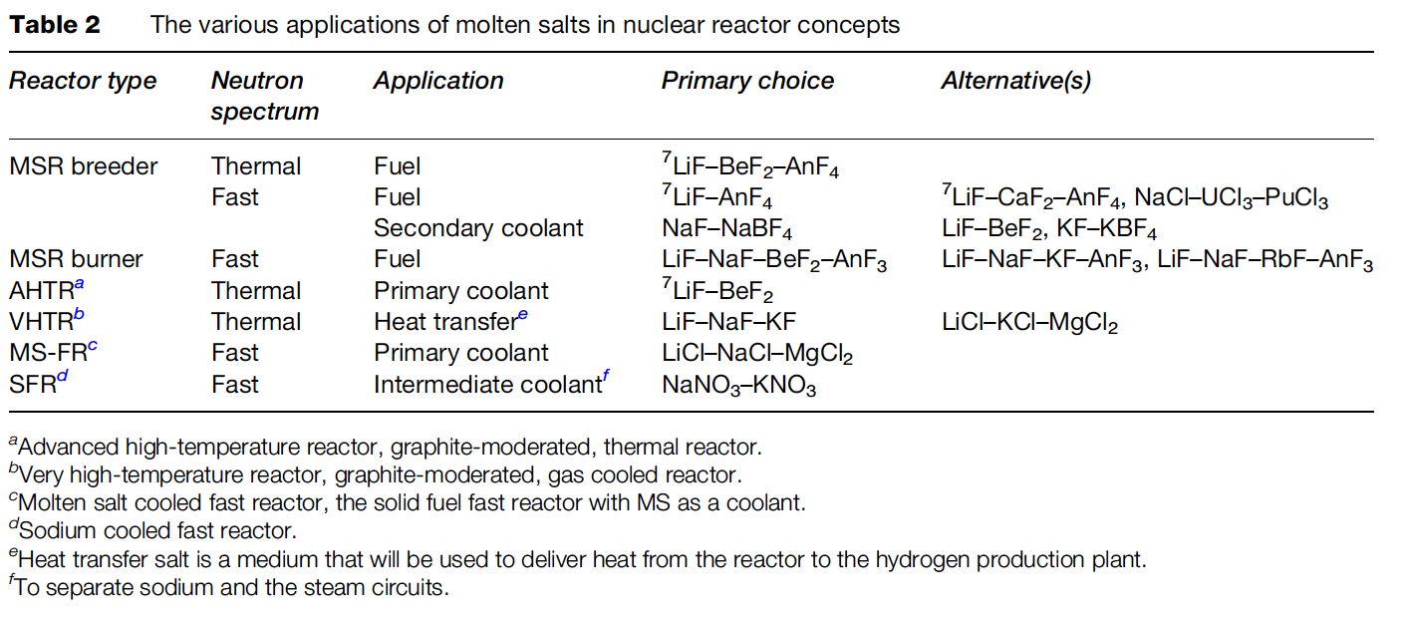
Molten Salt Applications

Slide 6
Benefits of MSRs
MSRs operate at or close to atmospheric pressure, rather than the 75-150 times atmospheric pressure of typical light-water reactors (LWR)
This reduces the large, expensive containment structures used for LWRs
Radioactive fission gases can be naturally absorbed into the molten salt
MSRs can have higher operating temperatures than a traditional LWR, providing higher electricity-generation efficiency, the possibility of grid-storage facilities, economical hydrogen production and, in some cases, process-heat opportunities.

Slide 7
Challenges of MSRs
The corrosivity of hot salts can break down cladding components and leech alloying elements
The changing chemical composition of the salt as it is transmuted by reactor radiation leads to changing properties
The processing of liquid transuranium molten salt fuel from the current spent fuel and of the on-line reprocessing of MSR fuel need to be solved

Slide 8
Beginning of MSRs
Aircraft Reactor Experiment was a 2.5 MWth thermal-spectrum nuclear reactor experiment designed to attain a high power density and high output temperature for use as an engine in a nuclear-powered bomber aircraft
It used the molten fluoride salt NaF-ZrF4-UF4 (53-41-6 mol%) as fuel, was moderated by a hexagonal-configuration beryllium oxide (BeO), and had a peak temperature of 860C

Slide 9
MSRE
The Molten-Salt Reactor Experiment (MSRE) was an experimental molten salt reactor at the Oak Ridge National Laboratory (ORNL); constructed by 1964, it went critical in 1965 and was operated until 1969

Slide 10
MSRE
MSRE was a circulating fuel type, utilizing LiF-BeF₂-ZrF₄-UF₄
The secondary coolant salt was LiF-BeF₂ (FLiBe), and the moderator was graphite
Salt-facing component were made of Hastelloy-N, which is a low chromium, nickel–molybdenum alloy

Slide 11
Fuel and Coolant Salts
A fuel salt is a molten salt that contains fissile material
Fuel salts consist of a mixture of some of all of the following:
Fissile material
Fertile material
Solvent (Lowers melting point, Decreases power density, Decreases viscosity)
Fissile oxidation prevention material
Fission products
Coolant salts are molten salts with advantageous heat transfer properties

Slide 12
Fuel Salt Requirements
Low neutron absorption
Radiolytic stability under in-core conditions
Dissolve fissile materials
High heat capacity, high boiling point, high thermal conductivity fluids
Melting point must be below ~525C
Relatively insensitive to fission products
Both fluoride and chloride salts, under mildly reducing conditions, are reasonably compatible with high temperature structural alloys and graphite

Slide 13
Fuel Salt Classes
Thermal spectrum reprocessing optimized fluoride salts
FLiBe (⁷LiF-BeF₂) and NaF-ZrF₄
FLiBe produces tritium, while NaF-ZrF₄ has a higher vapor pressure
Fast spectrum and thermal spectrum, once-through fuel cycle optimized fluoride salts
LiF-ThF₄-UF₄-(TRU)F₃
Much higher fissile loading (actinide-rich eutectics)
Adequate fissile material content is a significant design challenge
Chloride salts
Enables harder neutron spectrum and enhanced breeding
Isotopically separated chlorine preferable - ³⁵Cl from ³⁷Cl, due to moderate capture cross section of ³⁵Cl

Slide 14
Fluorides or Chlorides
Fluoride fuel salts have substantially more experimental data than chloride fuel salts, primarily due to history of MSRs in the thermal spectrum
Fluorides have been operated in molten salt reactors, been tested in multiple in-pile loops, with many capsule tests
Chloride salts have a history of laboratory measurements of physical properties, but no in-core testing of fuel salts
have extensive use in pyro-processing

Slide 15
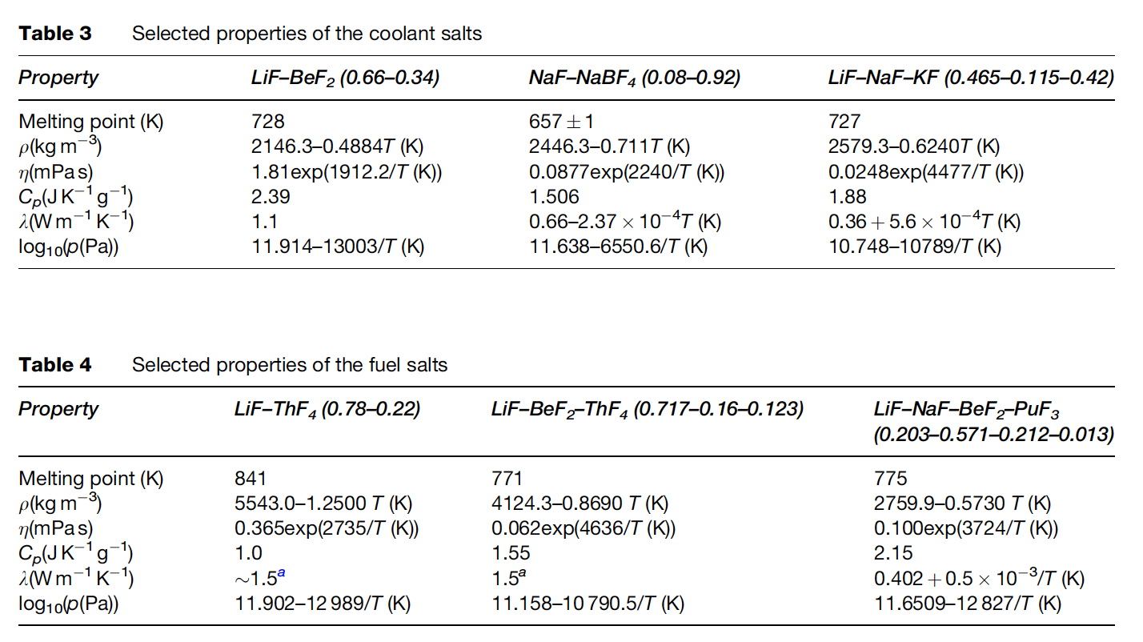
MSR Fuels
The fuel in the MSR must fulfill several requirements with respect to its physicochemical properties
These include low melting point, high solubility of relevant species, low viscosity, high heat capacity, high thermal conductivity, low volatility/vapor pressure, neutron transparency

Slide 16
Neutron Economy
Thermal spectrum molten salt fuels were identified as candidates for breeding (converting fertile into fissile), specifically in the thorium fuel cycle
Li-Be-F salts were selected because of the low thermal neutron cross sections of ⁷Li (σ_{th} = 0.045 b) and Be (σ_{th} =0.0088 b)
Natural lithium cannot be used as part of the nuclear fuel as it contains about 7.6% of ⁶Li (the remaining 92.4% is ⁷Li), which has a very high parasitic neutron capture cross-section (σ_{th} = 940 b)
Therefore, enrichment of ⁷Li is required before it can be used in the core

Slide 17
Fast Spectrum MSRs
Current MSR designs move away from thermal graphite-moderated concepts, and favor non-moderated concepts that have a fast(er) neutron spectrum and can function to burn radioactive waste
Fuel selection for the non-moderated reactor concepts is more flexible, and elements other than ⁷Li can be considered
The neutron capture cross-section of the alkali halides and alkali-earth halides is generally lower in the ‘fast’ spectrum than in the thermal spectrum
Compounds like NaF, KF, RbF, or CaF2 can be considered as part of the fuel matrix
There are also some ‘fast’ MSR concepts which are based on chloride salts

Slide 18
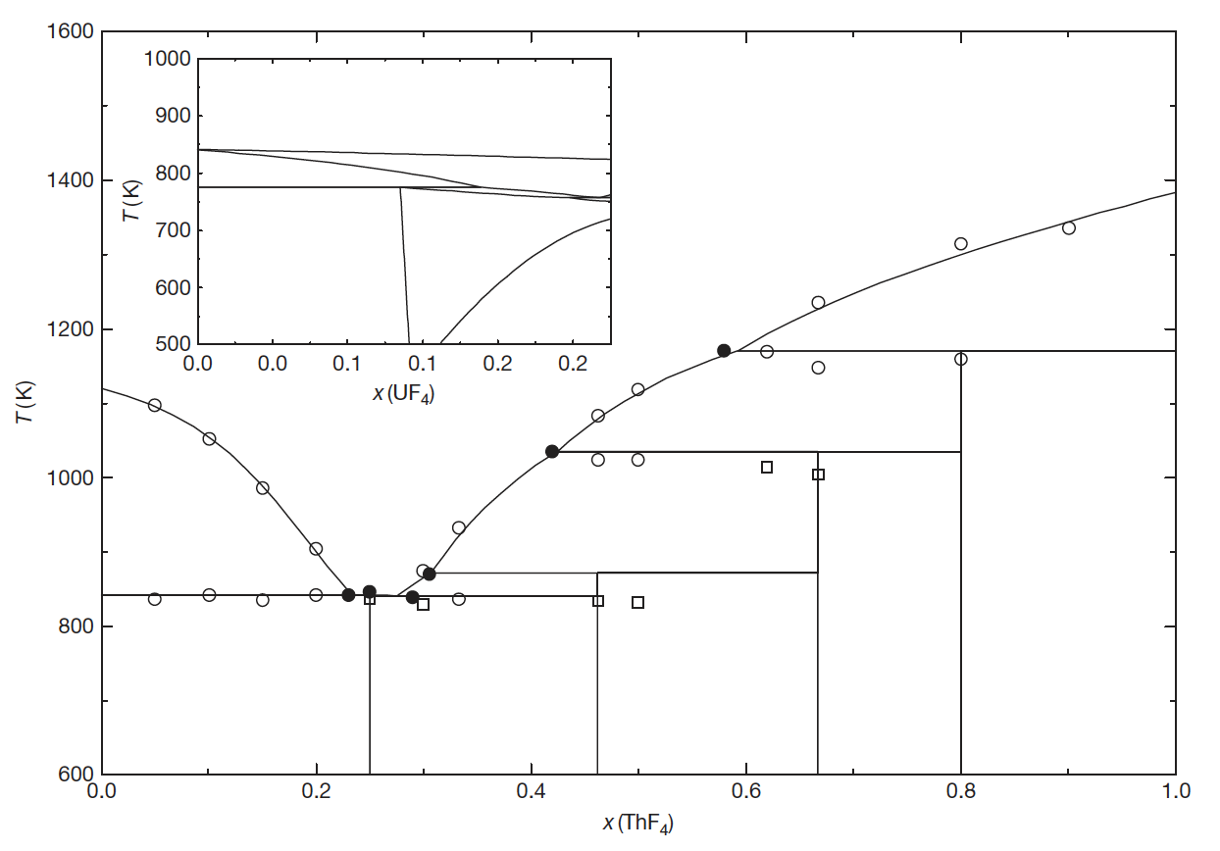
Solubility
The solubility of ThF4 in a matrix of LiF can be deduced from the binary phase diagram
For example, the solubility of ThF4 in a melt of LiF for T 903K (inlet temperature of the MSFR) is between 20.0 and 32.3 mol%
Compositions in this range are, thus, of interest as fuel for MSRs

Slide 19
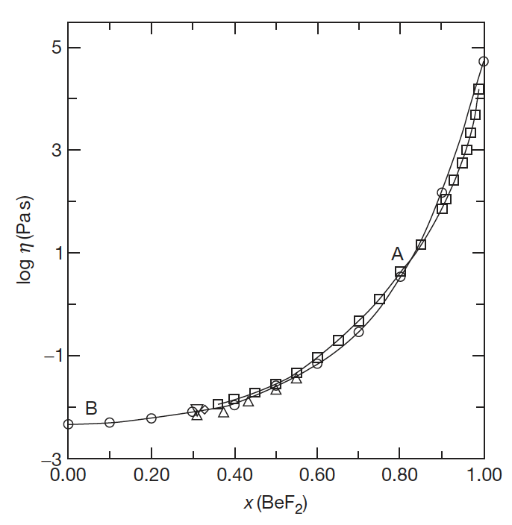
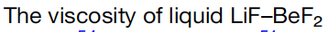
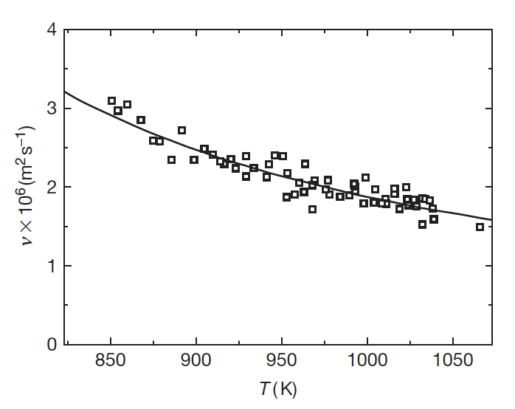
Low Viscosity
The viscosity of a fluid is a measure of its resistance to deformation at a given rate; conceptualized as the internal frictional force that arises between adjacent layers of fluid that are in relative motion
Lower viscosity results in less force to move the fluid at a given velocity
It is sometimes more convenient to utilize the kinematic viscosity, defined as the ratio of the viscosity μ to the density of the fluid ρ
The viscosity of fluoride systems shows significant non-ideal mixing behavior
Thus it is not possible to accurately estimate the viscosity of the fluoride salts, and therefore more measurements are required

Slide 20
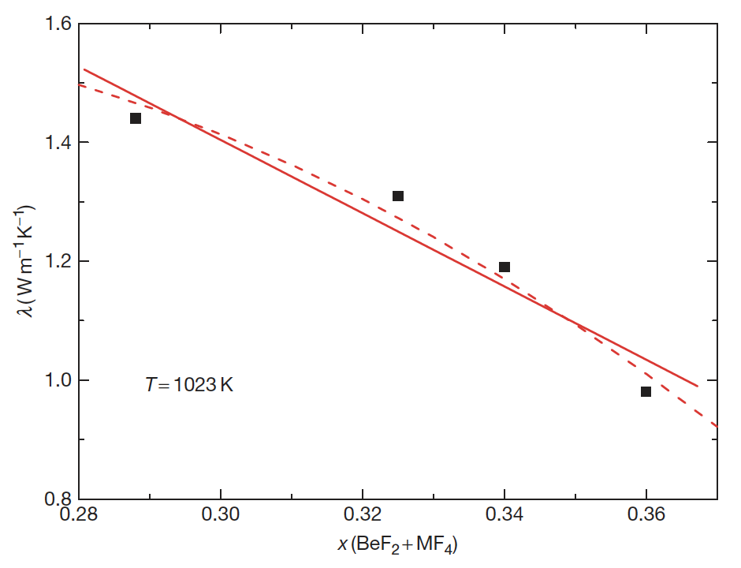
Heat Capacity and Thermal Conductivity
Heat Capacity is defined as the amount of heat to be supplied to an object to produce a unit change in its temperature
High heat capacity enables a small amount of the refrigerant to transfer a large amount of heat very efficiently
Data on experimental heat capacity and thermal conductivity of molten fluoride systems containing actinide fluorides are generally lacking
The thermal conductivity of a material is a measure of its ability to conduct heat
High thermal conductivity and thermal diffusivity will increase the rate of heat transfer through the fluid

Slide 21
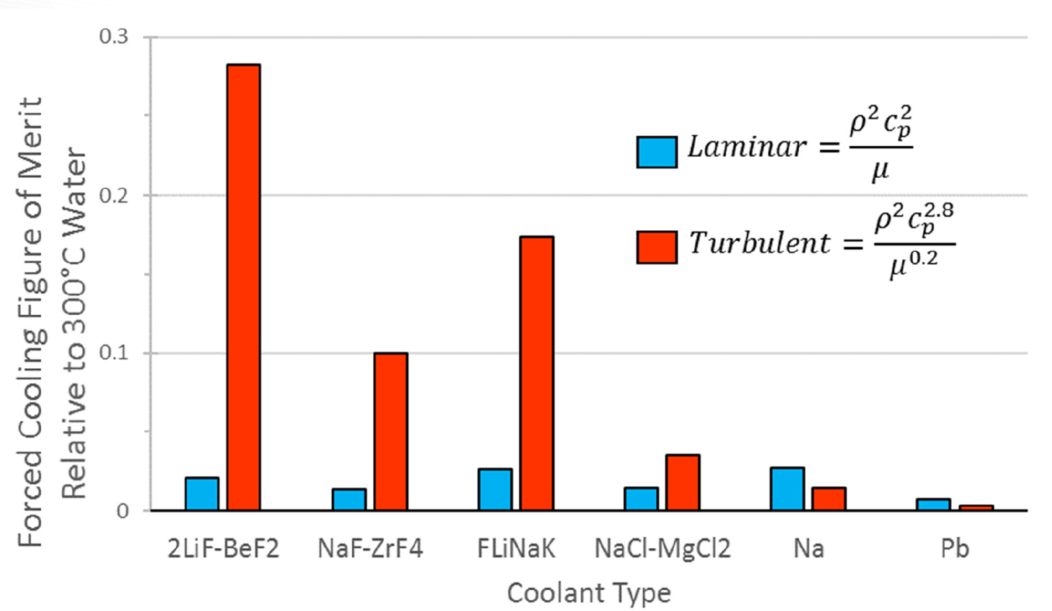
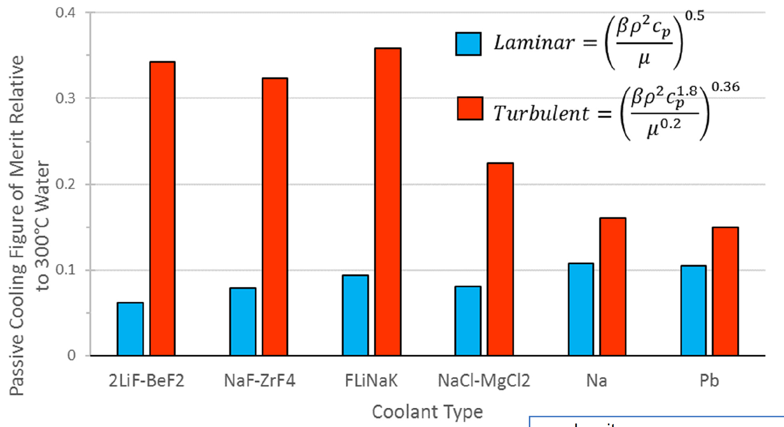
Heat Transfer
Large heat capacity and low viscosity are key properties allowing good heat transfer in molten salts
In both forced flow and passive cooling conditions, molten salts out perform liquid metals in turbulent flow for heat transfer
However, experimental data for heat transfer is still significantly scattered for the range of relevant MSR conditions

Slide 22
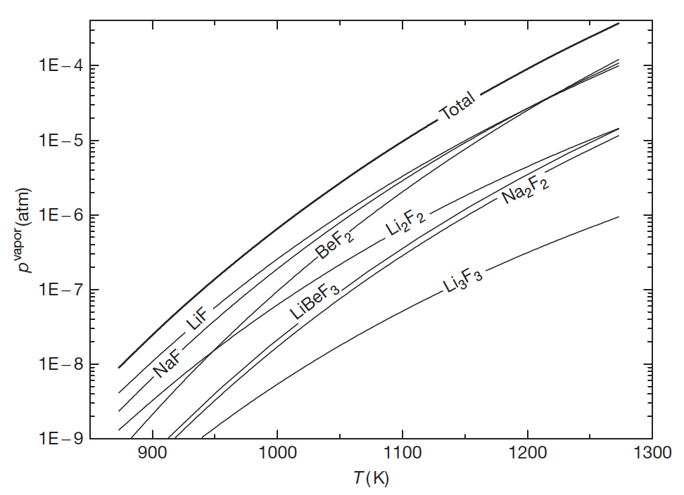
Vapor Pressure (Volatility)
Volatility is a material quality which describes how readily a substance vaporizes
a substance with high volatility is more likely to exist as a vapor, while a substance with low volatility is more likely to be a liquid or solid
Vapor pressure is a measurement of how readily a condensed phase forms a vapor at a given temperature
High vapor pressures indicate a high volatility, while high boiling points indicate low volatility
Salts should have high boiling and low freezing points, in addition to a low vapor pressure (low volatility)

Slide 23
Chemical Compatibility
For any high-temperature application, corrosion of the metallic container alloy is a primary concern
The products of oxidation of metals by molten salts tend to be completely soluble in the corroding media
Due to this solubility, passivation is precluded and the corrosion rate depends on other factors, including oxidants, thermal gradients, salt flow rate, and galvanic coupling
Examination of the free energies of formation for typical alloy components shows that chromium is the most active metal component
Thus, any oxidative attachment to these alloys should be expected to show selective attack on the chromium
Stainless steels, having more chromium than Ni-based alloys, are more susceptible to corrosion by fluoride melts

Slide 24
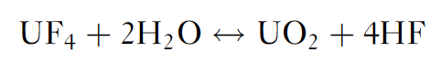
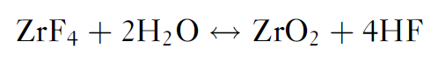
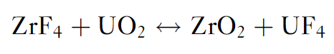
Role of Oxygen Impurities
The behavior of these systems can be significantly affected by the presence of the oxide ion that might be resulting from contamination of the salt system
Actinide oxides, such as UO2, can precipitate out for oxygen concentrations as low as 1E-4
Metal oxides have much higher melting points and therefore appear as insoluble components at operating temperatures
ZrF4 was implemented as an oxygen getter in the original MSRE fuels
AlCl₃ or CCl₄ can also be used as reactants to tie up oxygen, or strip O from UO2

Slide 25
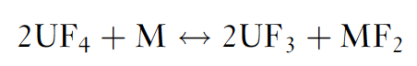
Role of Oxygen Impurities
Redox processes responsible for attack by fluoride mixtures on the alloys result in selective oxidation of the contained Cr
This removal of Cr from the alloy occurs primarily in regions of highest temperature
The rate of corrosion has been measured and was found to be controlled by the rate at which chromium diffuses to the surfaces undergoing attack
Reaction of UF₄ with structural metals (M) is strongly temperature dependent, and when the salt is circulated, a mechanism exists for mass transfer and continued attack
This reaction is of significance mainly in the case of alloys containing relatively large amounts of chromium

Slide 26
Control of Chemistry
Avoiding corrosion in an MSR or in fuel-processing units with metallic components is significantly more challenging than avoiding corrosion in clean salt coolant applications
The dissolved uranium and other such species in the fuel salt result in the presence of additional corrosion mechanisms
In clean salt applications, these types of corrosion mechanisms can be reduced or eliminated by (1) using purified salts that do not contain chemical species that can transport chromium and other alloy constituents or (2) operating under chemically reducing conditions
Redox control could be accomplished by including an HF/H₂ mixture

Slide 27
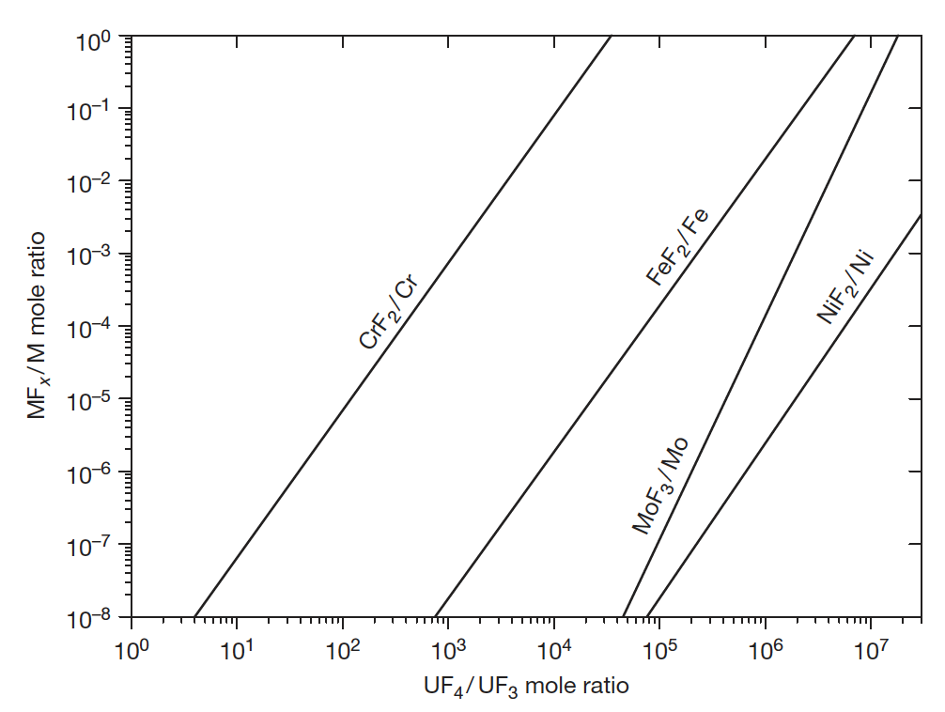
Maintaining Reducing Redox Conditions
Maintaining mildly reducing redox conditions is the key to enabling use of engineering alloys
Use of a circulating redox buffer provides means to maintain redox condition, while the oxidation states are changing due to fission
The ratio of U4+/U3+ serves as a measure of the redox potential of the salt for both chlorides and fluorides
Bottom right is the variation of equilibrium concentration of structural metal fluorides as a function of the UF4/UF3 ratio in a molten salt reactor fuel

Slide 28
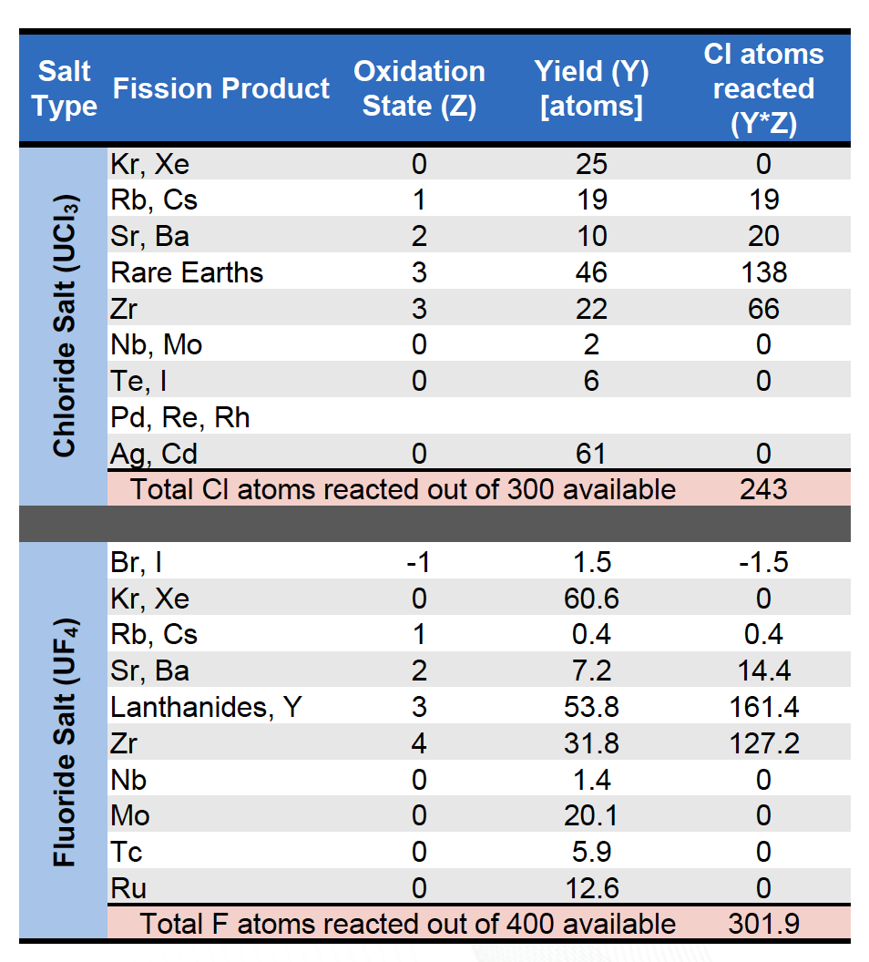
Changes During Fission
The fission process continuously alters the fuel salt redox conditions
When a U or Pu ion fissions, the available electrons will rearrange on each fission product to satisfy its valence requirements and produce either net oxidizing or reducing conditions in the melt
For UF4, four F ions are released; often fission products require less than four and thus there will be an excess of F ions with net oxidizing conditions

Slide 29
Fission Products
Distribution of fission products is a central safety issue
Fission products may be gaseous, solid, or dissolved
Alkaline and alkaline earth fission products form stable salts – Rb, Cs, Sr, Ba
Lanthanides and some transition metals can form stable salts
Semi-noble fission products plate out on metal surfaces – Nb, Mo, Tc, etc.
A few elements are very sensitive to redox changes
May elect to actively remove gaseous fission products
Lowers the in-core accident source term
Requires cooling fission product traps
Bubble formation and collapse results in reactivity jumps

Slide 30
Fission Product Plating
Noble metals are insoluble in the fluoride salt and can be found in helium sparge gas, on the graphite, or deposited on the metallic surfaces of the primary circuit
The deposited material contributes to the heat generation from its decay even after the reactor shutdown, decreasing the overall safety of the MSR
The deposits on the graphite specimens in the case of thermal reactors absorb neutrons during the operation and lead to lower efficiency of the reactor
One way of avoiding this detrimental precipitation is to remove the insoluble fission products by helium bubbling before they interact with the structural materials

Slide 31
Cover Gas
The cover gas (off-gas) handling system is a key element of any MSR
Fission gases such as xenon and krypton will readily escape the salt
Acidic gases may accumulate as a result of radiolysis
Tritium is formed by neutron interactions with light elements in the salt
The cover gas system will contain the radionuclides emerging from the free surface above the fuel salt as well as any sweep or sparging gases used

Slide 32
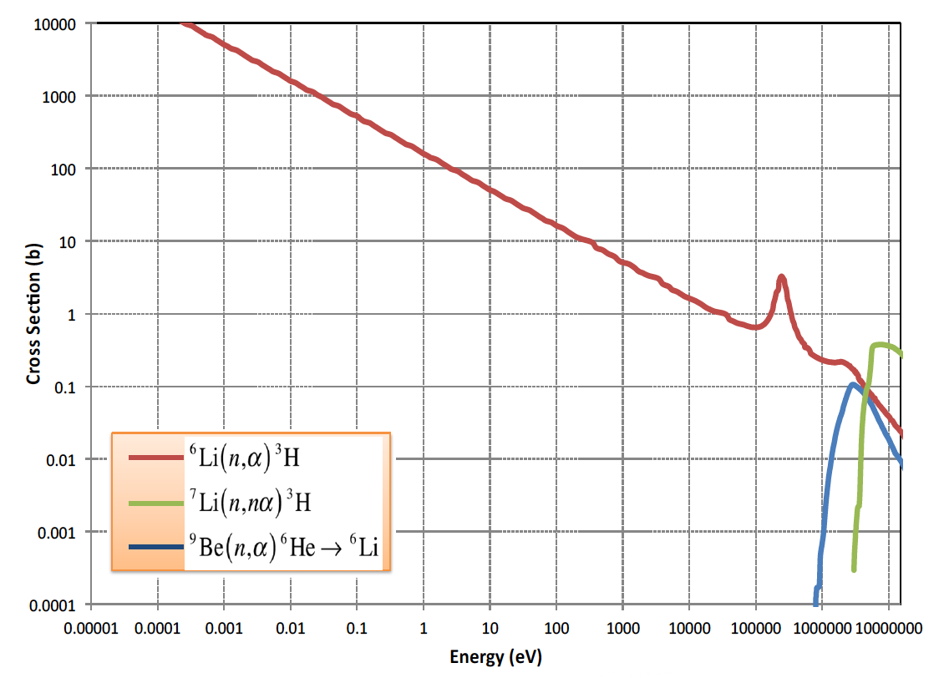
Tritium
Tritium production and control is an issue for Li-bearing salts
Tritium is produced by neutron reactions with lithium, beryllium, and fluorine as well as being a ternary fission product
Tritium can exist as ions of as TF, depending on redox conditions
Above 300C tritium will diffuse through structural materials

Slide 33
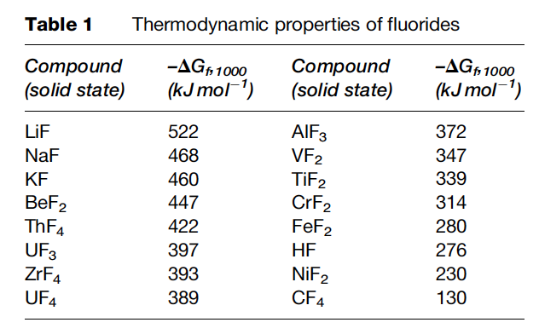
Radiolytic Stability
Molten salts are highly radiolytically stable
Radiolysis is the dissociation of molecules by ionizing radiation
Salts are combinations of strongly electronegative elements with strongly electropositive metals with very high bond energies
Formation energy of salts is more negative than metal fluorides
MSRE graphite and Hastelloy N exposed to coolant salt was untouched after ~3 years of operation

Slide 34
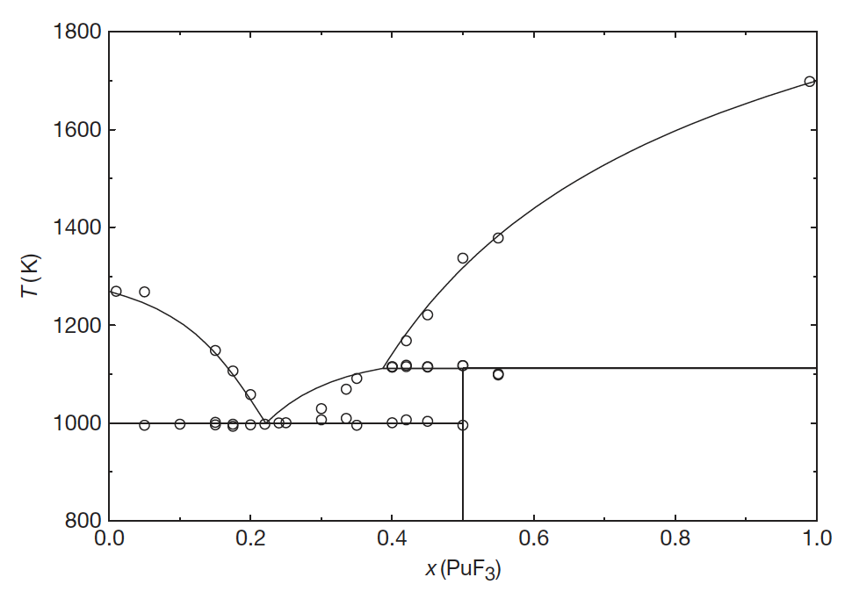
Na(ha)-Pu(ha)3

Slide 35
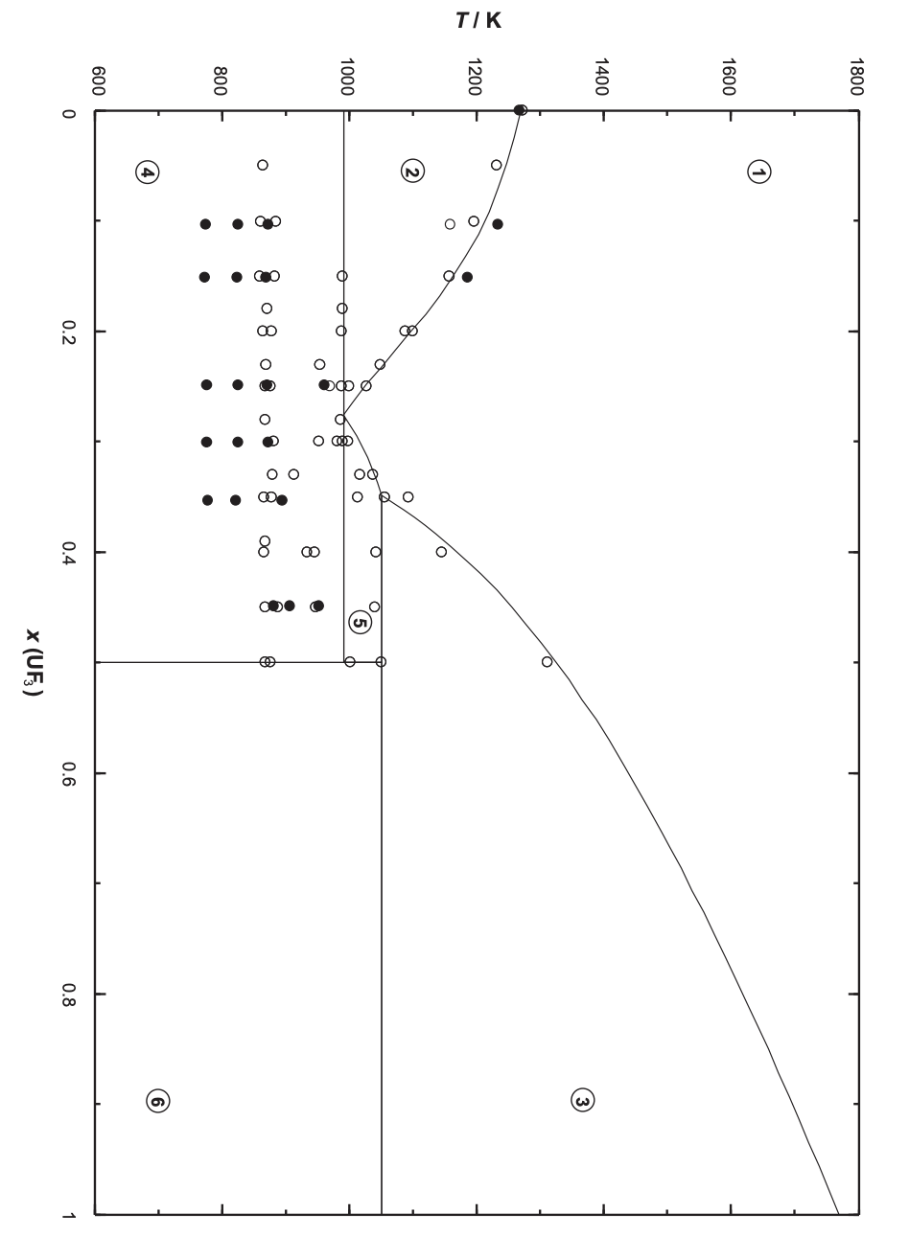
Na(ha)-U(ha)3

Slide 36
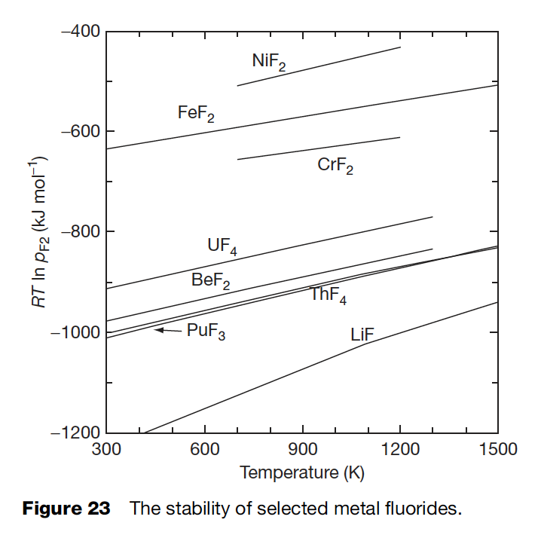
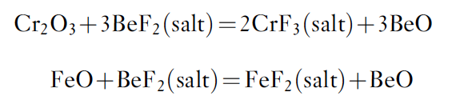
Corrosion of Structural Materials
Corrosion of the structural materials of the reactor by the molten salt may affect the chemistry and redox conditions of the fuel
The corrosion process to be considered in this context is the oxidation of metals in the alloy phase and their dissolution in the salt phase
Cr is the least stable element in relevant Ni-based alloys

Slide 37
Three principal corrosion processes
Reactions due to oxides on the metal
Reactions with dissolved impurities
Reactions with necessary constituents of the melt

Slide 38
Protective coatings?
It is not useful to apply a protective coating of, for example, an oxide layer on the structural material for the two following reasons:
although some oxides are relatively insoluble in the fluoride melt, most are readily dissolved
all oxides rapidly recrystallize
Oxide films on the surface of the alloy can be attacked by the fluoride melt
The formed oxides (BeO below) typically don’t matter as long as they do not contain fissile elements
The formed fluorides are more important as they will act as oxidants of Cr in the alloy

Slide 39
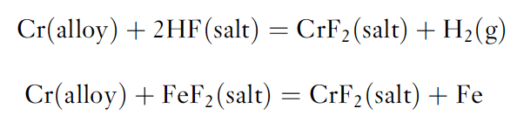
Dissolved Impurities
In addition to impurities generated by reactions with oxides, impurities may result from incomplete removal of HF or of easily reducible fluorides during the salt purification
This is done by successive reactions with HF–H2 and H2

Slide 40
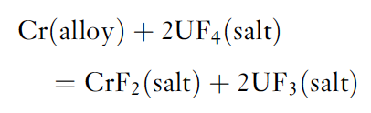
Constituents of the Melt
The oxidation reaction of alloy components with UF4 has been suggested to play an important role in corrosion
The below equation will define/buffer the electrochemical potential of the salt via the UF4/UF3 ratio
Based on reasonable estimations of the activity coefficients for the above reaction, the equilibrium concentration of CrF2 is of the order of 130–300 ppm for a fuel with 1% UF3 contained in Hastelloy-N

Slide 41
Tellerium
When Te is present in the metallic form in the fuel, it corrodes Ni-based alloys and embrittles its surface grain boundaries
Embrittlement is a vital issue to consider because it can result in cracking of the structural materials
This intergranular embrittlement produced in Hastelloy-N can be significantly reduced by adding 1–2 wt% of niobium into the Hastelloy-N
Another way to suppress the corrosion rate is by increasing the reducing conditions of the fuel, which is done by the increasing the UF3/UF4 ratio
This allows Te to be present as Te⁻² rather than in an ‘oxidized’ metallic form, and this is less aggressive against the nickel-based alloys

Slide 42
Isotope Separation
This is a significant issue for both fluoride and chloride salts
⁶Li has a large thermal neutron cross section
Absorption in ³⁵Cl both produces radioactive ³⁶Cl and results in a reactivity penalty
COLEX process utilizes mercury for Li separations

Slide 43
Summary
MSRs can be designed as a thermal (graphite-moderated), a nonmoderated breeder reactor, or as an actinide burner to manage the plutonium and the long-lived minor actinides
The thermodynamic description of the fuel systems is available and, based on these results, the liquidus temperatures, vapor pressures, and the solubility of actinide fluorides in the fuel solvent can be adequately derived, however, the addition of other matrix components must be investigated
There are strong data needs for viscosity, heat capacity, thermal conductivity, etc. for fresh salts, and essentially no data exists for irradiated salts
There is generally more data on fluoride salts than on chlorides
Corrosion of fuel salt on structural materials is very important, but can be mitigated through control of the REDOX potential

Slide 44
I can still add more on coolant salts
I can add more on corrosion
I need to go through comp. nucl. mater. ch 5.10

